Slide 1
Coursera IBM Data Science
The Battle of Neighborhoods

Slide 2
Overview
Combination of
Toronto neighborhoods data
Toronto‘s data on venues from Foursquare
Toronto‘s geospatial data
Goals:
Analyse most common venues in Toronto and most diverse areas
Give an overview of Toronto‘s venue density
Cluster Toronto‘s areas based on venue density

Slide 3
Example: Toronto‘s Neighborhoods based on Venue counts
 | Neighborhood | Venue | Venue Category
0 | Adelaide | 98 | 59
1 | Agincourt | 4 | 4
2 | Agincourt North | 2 | 2
3 | Albion Gardens | 11 | 10
4 | Alderwood | 11 | 10
5 | Bathurst Manor | 17 | 16
6 | Bathurst Quay | 14 | 11
7 | Bayview Village | 4 | 4
8 | Beaumond Heights | 11 | 10
9 | Bedford Park | 24 | 21
10 | Berczy Park | 54 | 41
11 | Birch Cliff | 4 | 4
12 | Bloordale Gardens | 8 | 8
13 | Brockton | 21 | 16
14 | Business reply mail Processing Centre969 Eastern | 16 | 15
15 | CFB Toronto | 3 | 3
16 | CN Tower | 14 | 11
17 | Cabbagetown | 44 | 33
18 | Caledonia-Fairbanks | 6 | 5
19 | Canada Post Gateway Processing Centre | 11 | 9
20 | Cedarbrae | 7 | 7
21 | Central Bay Street | 83 | 49
22 | Chinatown | 100 | 59
23 | Christie | 15 | 10
24 | Church and Wellesley | 86 | 59
25 | Clairlea | 10 | 9
26 | Clarks Corners | 8 | 7
27 | Cliffcrest | 2 | 2
28 | Cliffside | 2 | 2
29 | Cliffside West | 4 | 4
30 | Cloverdale | 1 | 1
31 | Commerce Court | 88 | 53
32 | Davisville | 38 | 26
33 | Davisville North | 8 | 8
34 | Deer Park | 14 | 12
35 | Del Ray | 5 | 4
36 | Design Exchange | 90 | 51
Neighborhood with most venues | St. James Town | 141
Neighborhood with most categ. | St. James Town | 78
Based on data frame manipulation, the venues and venue catgories of Toronto were grouped by their respective neighborhoods.

Slide 4
Toronto‘s density cluster for Restaurants /Food Places
 | Neighborhood | Venue Category | Cluster
0 | Adelaide | 54 | 1
1 | Agincourt | 1 | 2
2 | Albion Gardens | 5 | 2
3 | Alderwood | 5 | 2
4 | Bathurst Manor | 9 | 0
5 | Bathurst Quay | 1 | 2
6 | Bayview Village | 2 | 2
7 | Beaumond Heights | 5 | 2
8 | Bedford Park | 18 | 3
9 | Berczy Park | 29 | 3
10 | Bloordale Gardens | 2 | 2
11 | Brockton | 8 | 0
12 | Business reply mail Processing Centre969 Eastern | 3 | 2
13 | CN Tower | 1 | 2
14 | Cabbagetown | 27 | 3
15 | Caledonia-Fairbanks | 1 | 2
16 | Canada Post Gateway Processing Centre | 6 | 2
17 | Cedarbrae | 4 | 2
18 | Central Bay Street | 58 | 1
19 | Chinatown | 62 | 1
20 | Christie | 4 | 2
21 | Church and Wellesley | 55 | 1
22 | Clairlea | 3 | 2
23 | Clarks Corners | 5 | 2
24 | Cliffcrest | 1 | 2
25 | Cliffside | 1 | 2
26 | Commerce Court | 57 | 1
27 | Davisville | 23 | 3
Cluster | 0 | 1 | 2 | 3
Amount Venues | 296 | 1232 | 286 | 441
Count Neighbor | 29 | 23 | 100 | 19
Average Venues | 10,2069 | 53,56522 | 2,86 | 23,21053
Spread highest/lowest |  | 50,70522
The different clusters show quite a large spread between neighborhoods in terms of venue/restaurants amounts.
A large amount of neighborhoods either lack venues or were not considered often by Foursquare users.

Slide 5
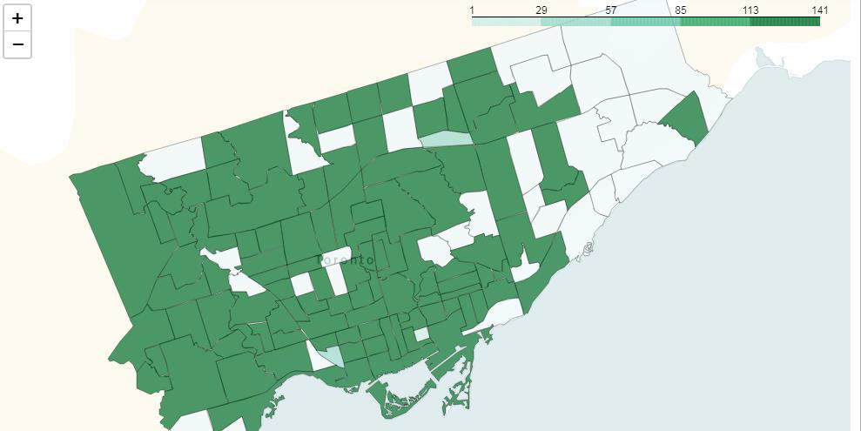
Toronto Choropleth Map: Venue Density
While several areas of Toronto are heavily populated by venues, the east side shows a very low density, while also containing a high number of individual neighborhoods in each of the outlined districts.

Slide 6
Conclusion
Toronto‘s venues seem unequally distributed or certain areas of Toronto are rarely visited by Foursquare users.
St. Jamestown seems very popular and should be recommended to Tourists.
There are several neighborhoods lacking a decent amount of restaurants.

